Slide 1
Corona Travel
by Everything is awesome
Task 6

Slide 2
Product description
Our goal in to allow users to travel online from home via any device of their liking. They'll start by opening an app or a link and choosing a desired destination. After choosing a location, users can choose to view destination in 3D, look at some 3D photos or videos or learn some facts about the place.
Team: Artem Filimonov, Danil Kireev, Elena Karelina, Sofya Donskaya
Repo: https://github.com/randomunrandom/corona_travel
Report: https://docs.google.com/presentation/d/1JACCD4vOj-xfGJL7mi7mC_b7NtI9dnsqhpJfpyEJdkU/edit?usp=sharing

Slide 3
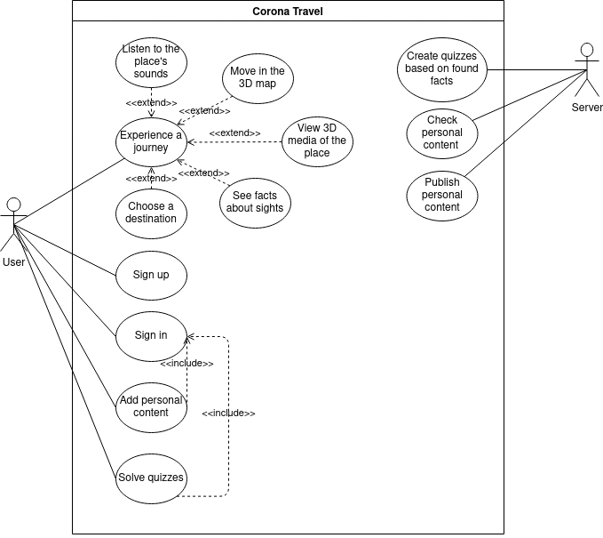
Use case diagram

Slide 4
4 Top Use Cases with the corresponding main scenarios
User chooses one of available journeys from list. After confirmation a virtual journey should be launched. User moves via a map, and the map shows places.
User sees 3D Media of a place, clicks on any point of the area. After that user should see the surrounding of the chosen point.
User sees the button for playing audio of the place. If the user clicks the button the corresponding audio sound is played.
While experiencing journey the user sees facts about the destination that are depicted in a specified area of the user interface.

Slide 5
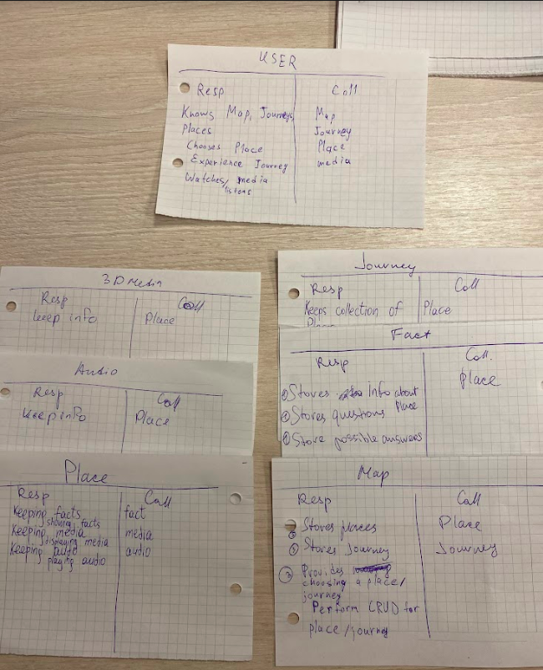
Interaction analysis

Slide 6
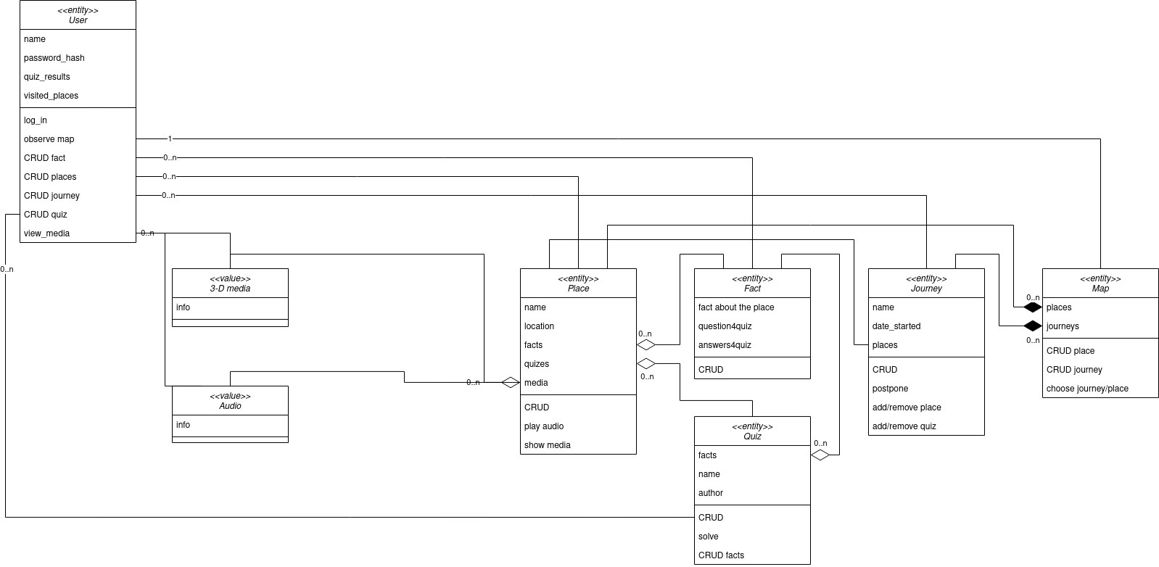
Updated class diagram

